Slide 1
Systems Analysis and Design 11th Edition
Chapter 12 Managing Systems Support and Security

Slide 2
Chapter Objectives
Explain the systems support and security phase
Describe user support activities, including user training and help desks
Define the four types of maintenance
Explain various techniques for managing systems maintenance and support
Describe techniques for measuring, managing, and planning system performance
Explain risk management concepts

Slide 3
Chapter Objectives (Cont.)
Assess system security at six levels: physical security, network security, application security, file security, user security, and procedural security
Describe backup and disaster recovery
List factors indicating that a system has reached the end of its useful life
Assess future challenges and opportunities for IT professionals
Develop a strategic plan for career advancement and strong IT credentials

Slide 4
Introduction
Systems support and security phase begins when a system becomes operational
Continues until the system reaches the end of its life
After delivering the system, the IT team focuses on support and maintenance tasks
Concerns in managing systems support and security
User expectations
System performance
Security requirements

Slide 5
User Support
User Training
IT Department may develop a user training package
Training users about system changes is similar to initial training
Objective - To show users how the system can help them perform their jobs
Help or Service Desks: Provide support and guidance

Slide 6

User Support (Cont. 1)
Objectives
To show people how to use system resources more effectively and provide answers to technical or operational questions
To make users more productive by teaching them how to meet their own information needs
Boost their productivity using remote control software
Remote control software: Allows IT staff to take over a user’s workstation and provide support and troubleshooting
Figure 12-2 A help desk, also called a service desk, provides support to system users.

Slide 7
User Support (Cont. 2)
Outsourcing Issues
Offshore call centers can trim expenses and free up valuable human resources for product development
Customers may shop elsewhere if the quality of tech support decreases
Critical factors
Phone wait times
Performance of support staff
Online support tools

Slide 8
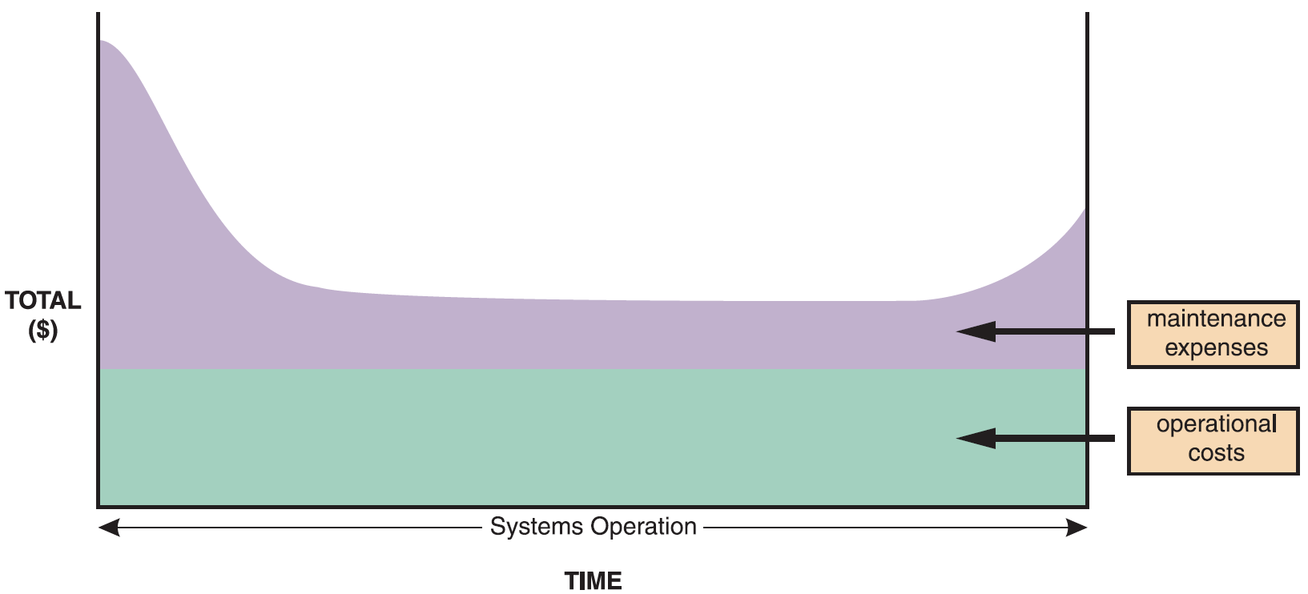
Maintenance Tasks
Figure 12-3 The total cost of operating an information system includes operational and maintenance costs. Operational costs (green) are relatively constant, while maintenance costs (purple) vary over time.

Slide 9
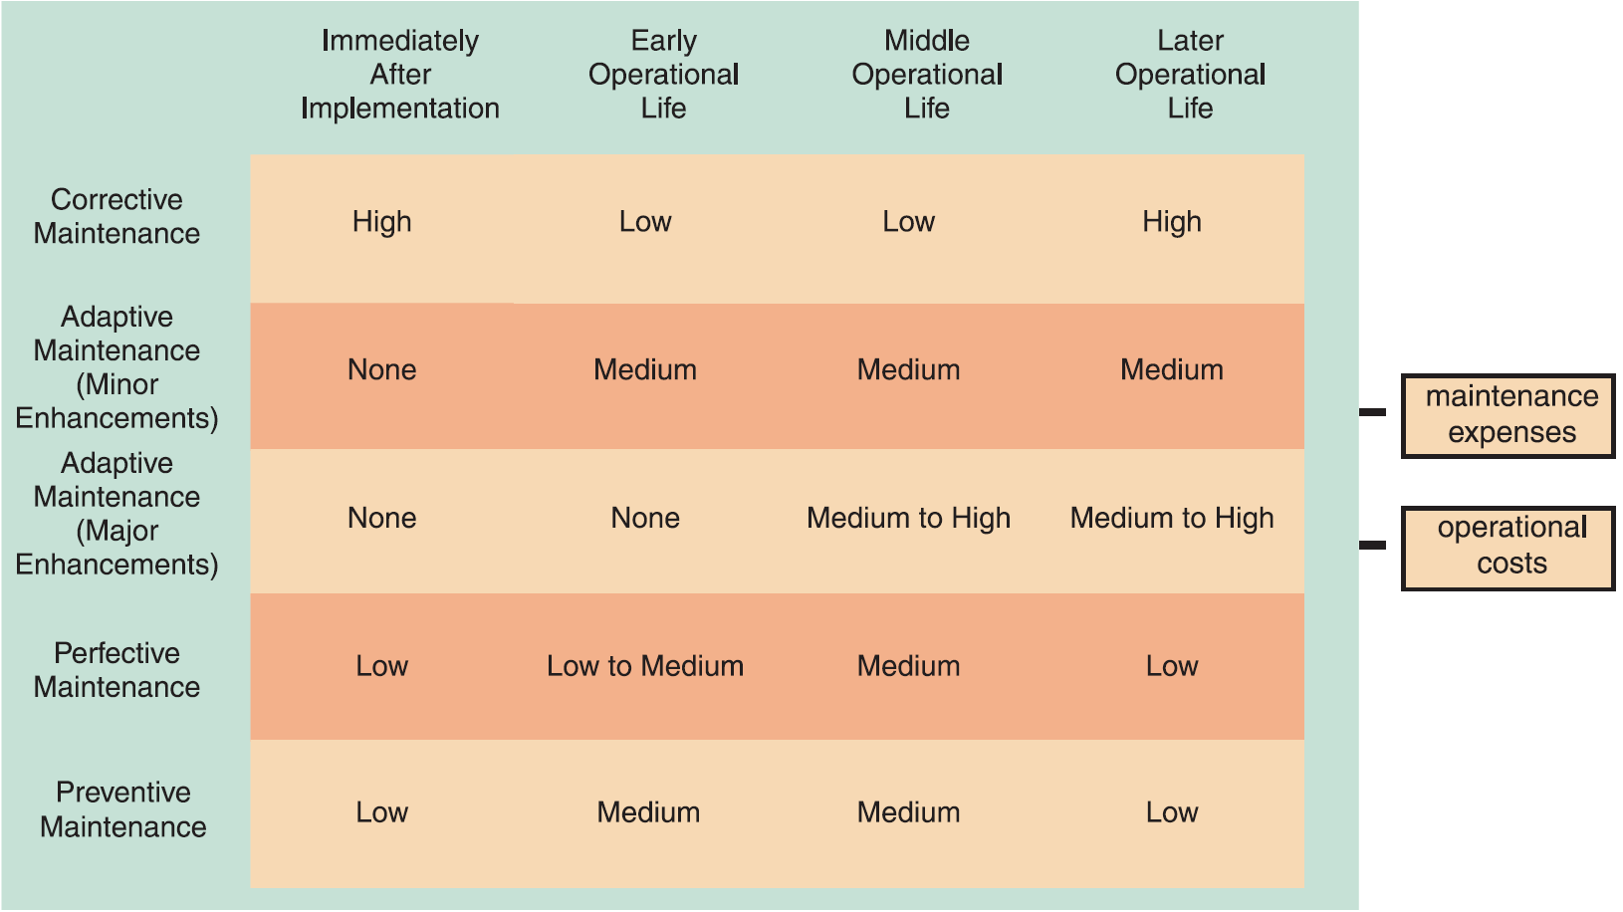
Maintenance Tasks (Cont. 1)
Figure 12-5 Information systems maintenance depends on the type of maintenance and the age of the system.

Slide 10
Maintenance Tasks (Cont. 2)
Corrective Maintenance
Diagnoses and corrects errors in an operational system
Standard procedures are set for minor errors
Worst-case situation is a system failure
Requires a patch
When the system is operational again, the maintenance team determines the cause, analyzes the problem, and designs a permanent solution

Slide 11
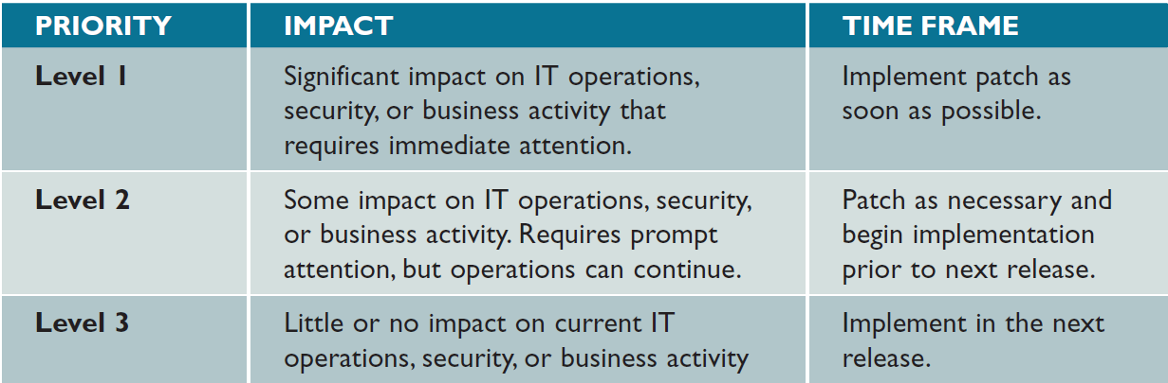
Maintenance Tasks (Cont. 3)
Figure 12-6 This three-level ranking framework for IT support considers potential impact and response urgency.

Slide 12
Maintenance Tasks (Cont. 4)
Adaptive Maintenance
Adds enhancements to an operational system and makes the system easier to use
Procedure for minor adaptive maintenance is similar to routine corrective maintenance
Users submit requests that are evaluated and prioritized by the systems committee
Can be more difficult than new systems development
Enhancements must work within the constraints of an existing system

Slide 13
Maintenance Tasks (Cont. 5)
Perfective Maintenance
Changing an operational system to make it more efficient, reliable, and maintainable
Cost-effective during the middle of the system’s operational life
Performed using software reengineering
Software reengineering: Uses analytical techniques to identify potential quality and performance improvements in an information system
The more a program changes, the more likely it is to become inefficient and difficult to maintain

Slide 14
Maintenance Tasks (Cont. 6)
Preventive Maintenance
Requires analysis of areas where trouble is likely to occur
IT department initiates preventive maintenance
Results in:
Increased user satisfaction
Decreased downtime
Reduced TCO
Competes for IT resources along with other projects

Slide 15
Maintenance Management
The Maintenance Team
System administrator: Manages computer and network systems
Systems analysts - Investigate and locate the source of a problem using analysis and synthesis skills
Programmers - Include applications programmers, systems programmers, and database programmers
Organizational issues
Organizations have groups that perform maintenance and new systems development
May rotate people from one assignment to the other

Slide 16
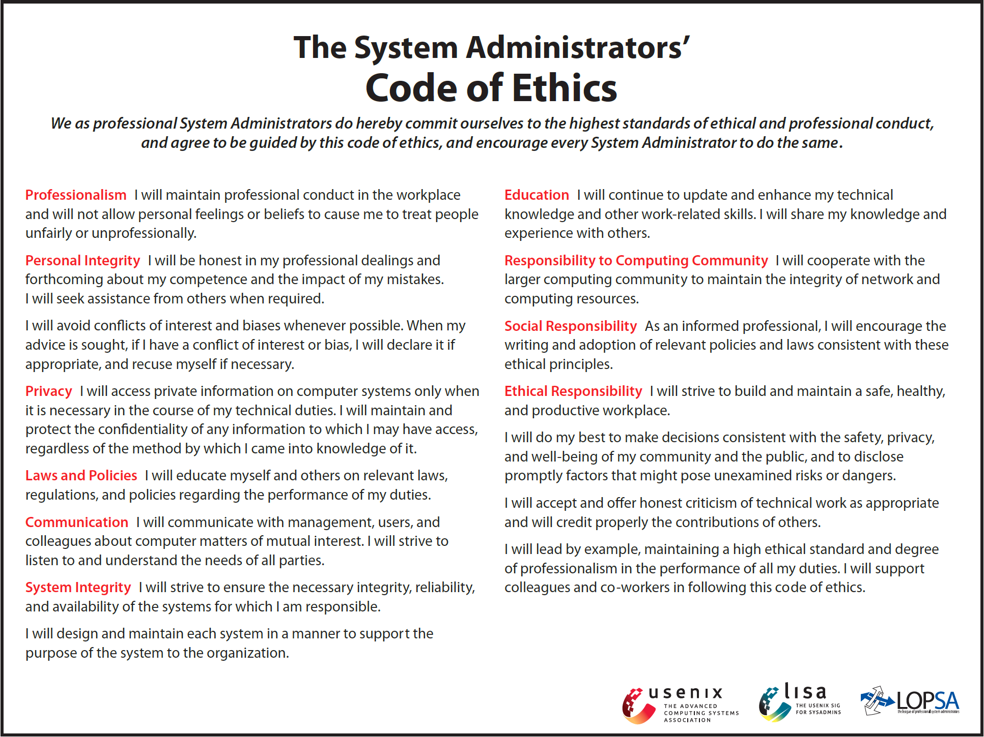
Maintenance Management (Cont. 1)
FIGURE 12-9 LISA seeks to establish standards of professional conduct for its members.
Source: ©2014 The USENIX Association

Slide 17
Maintenance Management (Cont. 2)
Maintenance Requests
Involve a series of steps
Initial determination
Consideration by the systems review committee
Task completion and user notification
Establishing Priorities
Systems review committees may either separate maintenance requests from new systems development requests or evaluate all projects together
Objective - To have a procedure that balances new development and necessary maintenance work

Slide 18
Maintenance Management (Cont. 3)
Configuration Management or Change Control (CC)
Controls changes in system requirements during software development
Becomes critical as enterprise-wide information systems grow more complex
Important to systems with multiple versions running in different hardware and software environments
Helps in organizing and handling documentation

Slide 19
Maintenance Management (Cont. 4)
Maintenance Releases
Documents and installs changes as a new version
Maintenance release methodology: Retains all noncritical changes and implements them simultaneously
Advantage - All changes are tested together, resulting in fewer versions and lesser expense
Disadvantage - New features of upgrades are available less often
Service packs: Maintenance releases provided by commercial software suppliers

Slide 20
Maintenance Management (Cont. 5)
Version Control
Process of tracking system releases or versions
Prior release is archived and restored in case the new version fails
Firms use commercial applications that handle version control for complex systems
Baselines
Measure system characteristics at a specific time
Types - Functional, allocated, and product

Slide 21
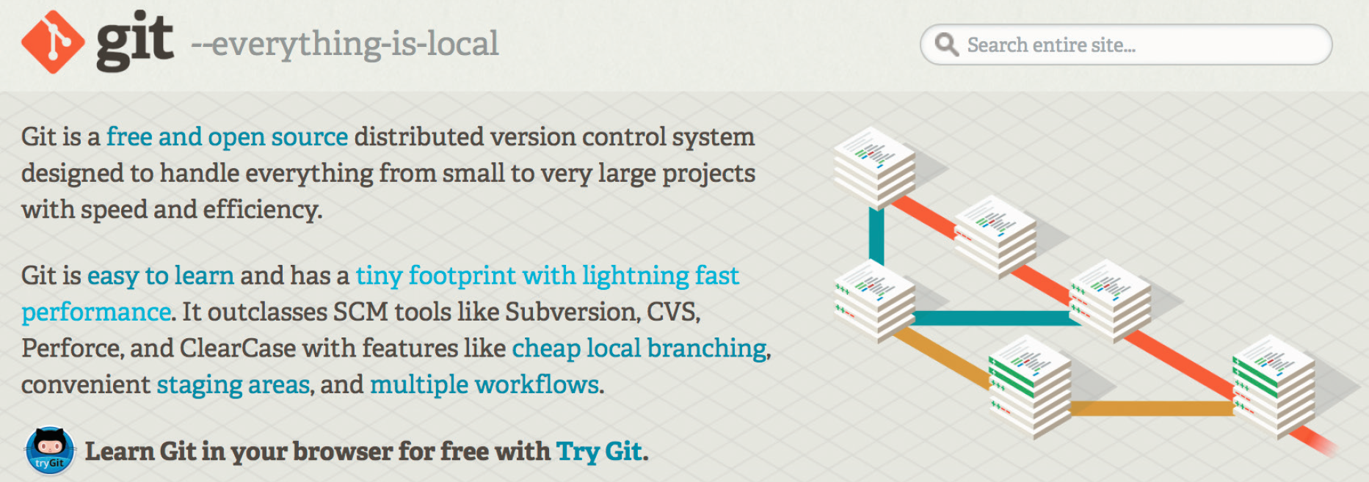
Maintenance Management (Cont. 6)
Figure 12-13 Git is a popular free version control system.
Source: git-scm.com

Slide 22
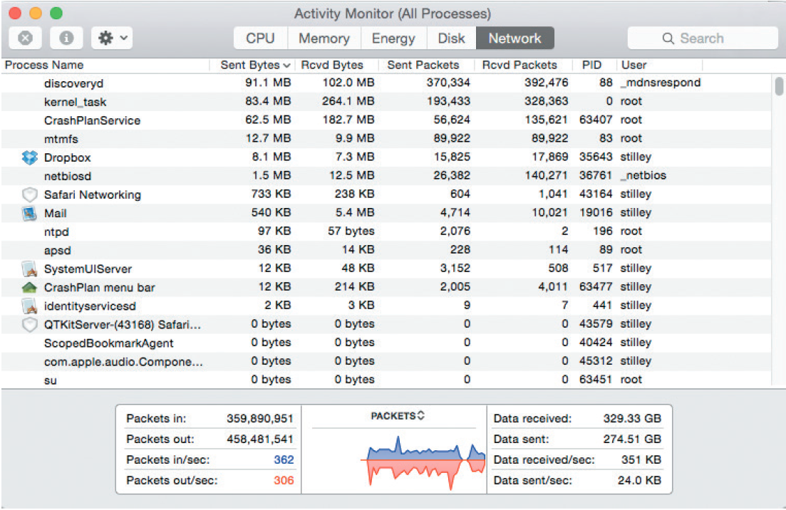
System Performance Management
Fault Management
Includes monitoring the system for signs of trouble, logging all system failures, diagnosing the problem, and applying corrective action
Figure 12-14 The Activity Monitor application on Apple’s Mac OS X displays CPU, memory, energy, disk, and network activity of all running applications in real time.
Source: Apple

Slide 23
System Performance Management (Cont. 1)
Performance and Workload Measurement
System performance is measured using benchmark testing and metrics
Response time: Overall time between a request for system activity and the delivery of the response
Bandwidth and throughput
Can be measured in Kbps (kilobits per second), Mbps (megabits per second), and Gbps (gigabits per second)
Examples of standards of metrics
Arrivals - Number of items that appear on a device during a given observation time
Busy - Time that a given resource is unavailable

Slide 24
System Performance Management (Cont. 2)
Queue length - Number of requests pending for a service
Turnaround time: Applies to centralized batch processing operations
Measures the time between submitting a request for information and the fulfillment of the request
Used to measure the quality of IT services
Management uses current performance and workload data as input for the capacity planning process

Slide 25
System Performance Management (Cont. 3)
Capacity Planning
Monitors current activity and performance levels
Anticipates future activity and forecasts resources required to provide desired levels of service
Uses what-if analysis
What-if analysis: Varies one or more elements to study their effect on other elements
Requires:
Detailed information
An accurate forecast of future business activities
Objective - To develop contingency plans based on input from users and management

Slide 26
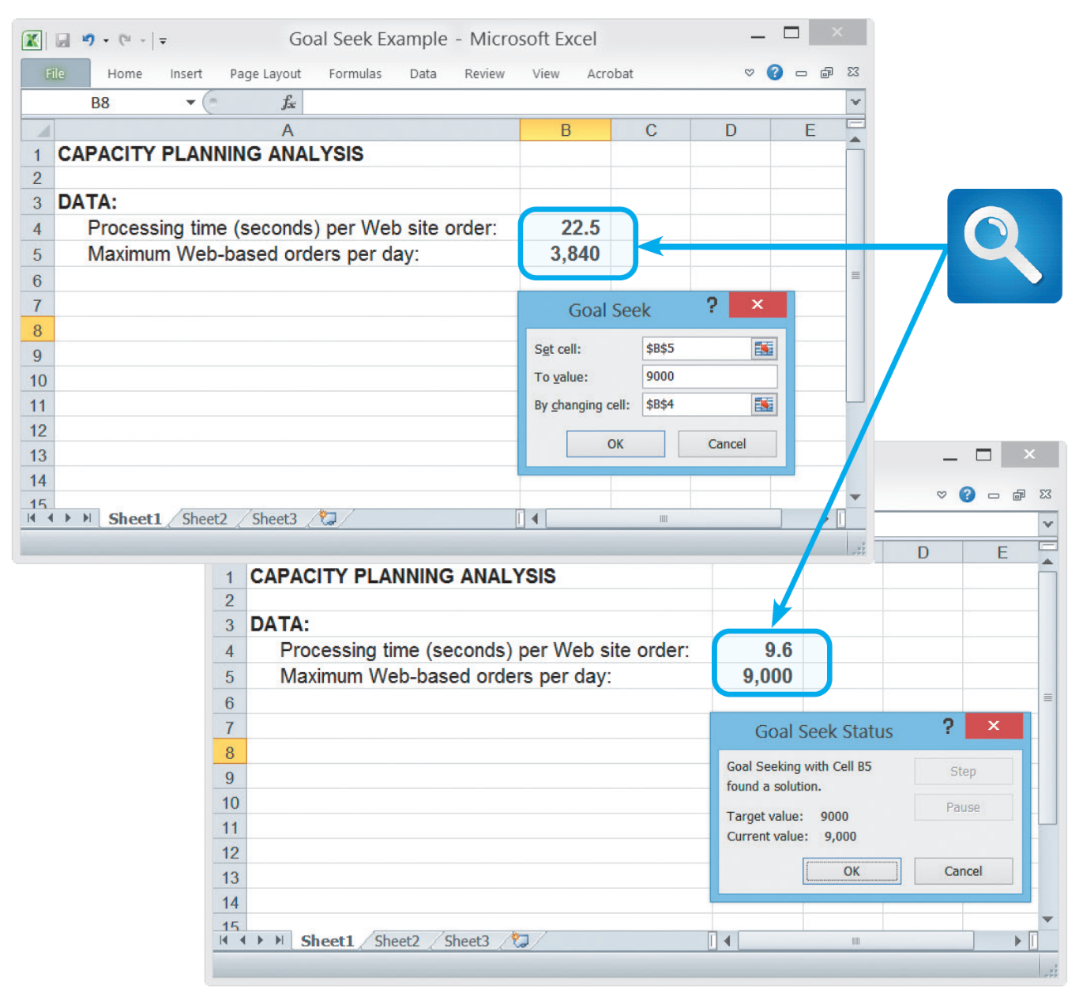
System Performance Management (Cont. 4)
Figure 12-16 In this Goal Seek example, the user wants to know the effect on processing time if the number of daily transactions increases from 3,840 to 9,000.

Slide 27
System Performance Management (Cont. 5)
System Maintenance Tools
Many CASE tools include system evaluation and maintenance features
Spreadsheet and presentation software can be used to calculate trends, perform what-if analyses, and create charts and graphs

Slide 28
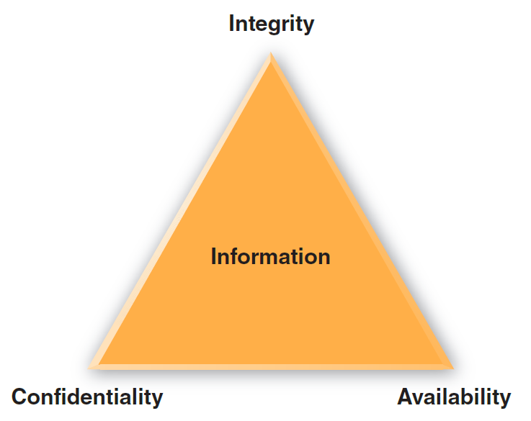
System Security Overview
Security is a vital part of every computer system
System Security Concepts
CIA triangle: Shows the main elements of system security
Elements are used to develop a security policy
Figure 12-18 System security must provide information confidentiality, integrity, and availability (CIA).

Slide 29
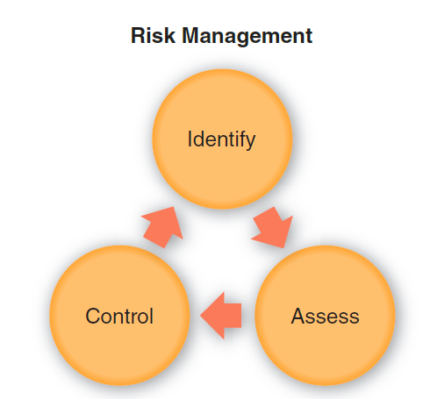
System Security Overview (Cont. 1)
Risk Management: Involves:
Risk identification
List and classify assets and analyze possible threats
Identify vulnerabilities and how they might be exploited
Risk assessment
Risks need to be calculated and prioritized
Risk control
Strategies - Avoidance, mitigation, transference, and acceptance
Figure 12-19 Risk management requires continuous risk identification, assessment, and control.

Slide 30
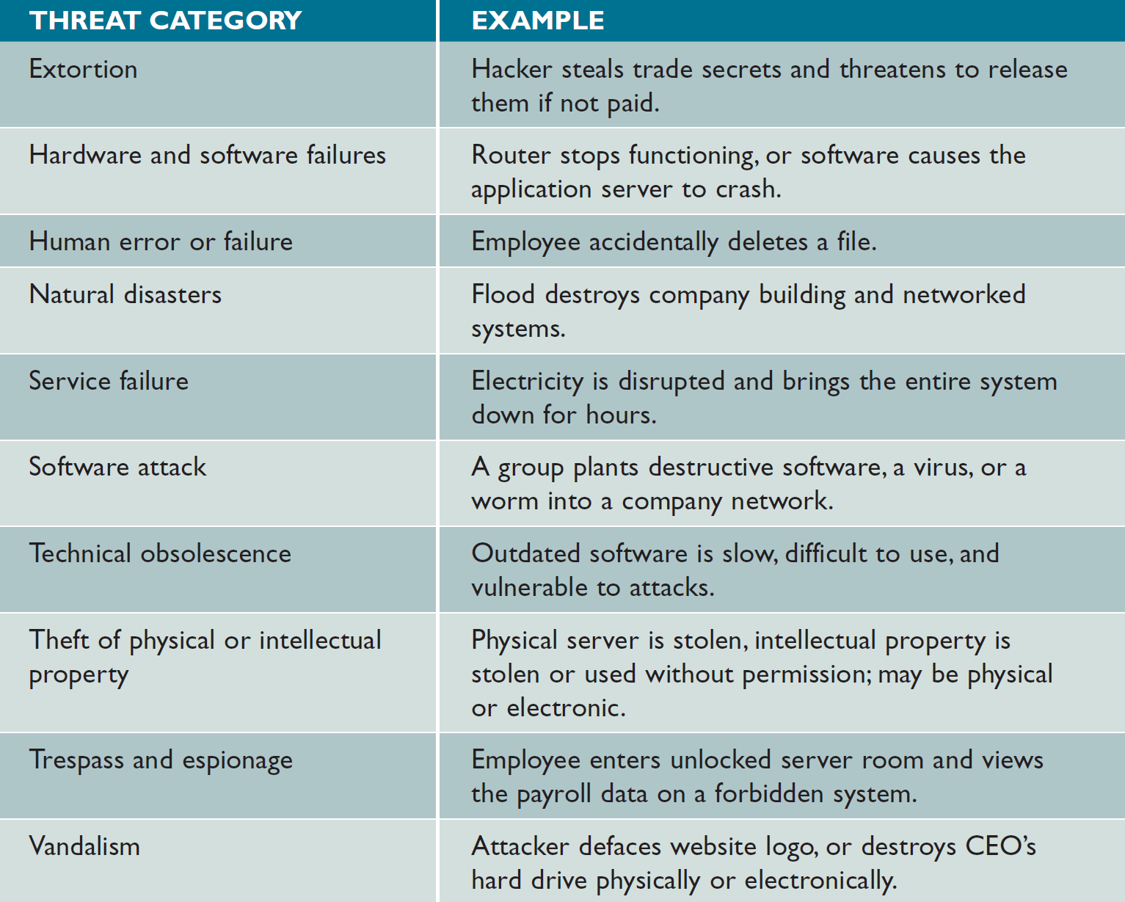
System Security Overview (Cont. 2)
Figure 12-20 System threats can be grouped into several broad categories.

Slide 31
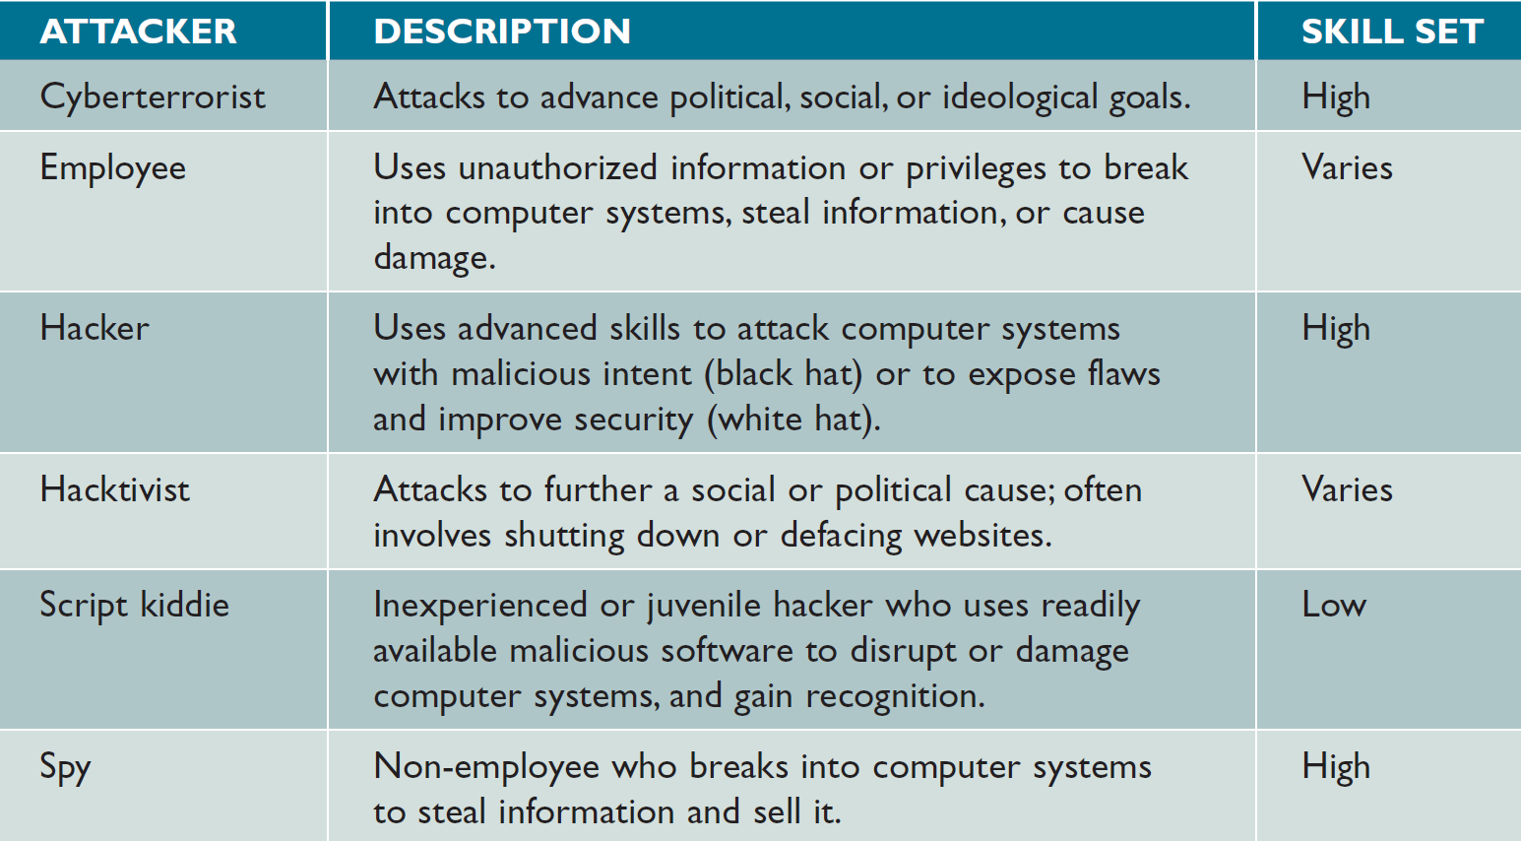
System Security Overview (Cont. 3)
Figure 12-21 IT security professionals have names for various types of attackers.

Slide 32
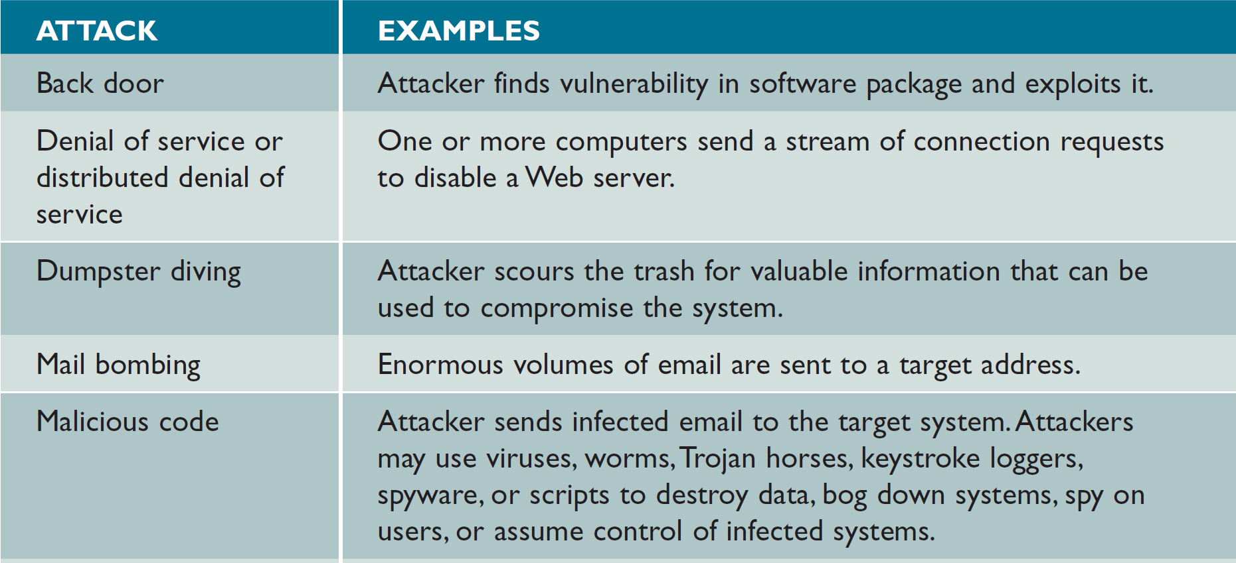
System Security Overview (Cont. 4)
Figure 12-22 Attacks can take many forms, as this table shows. IT security managers must be able to detect these attacks and respond with suitable countermeasures.

Slide 33
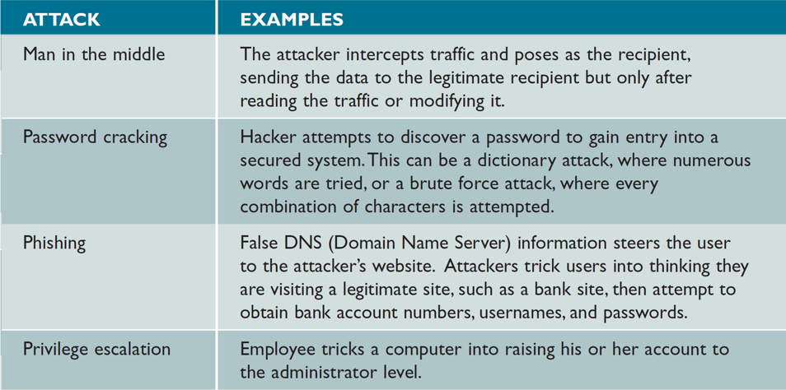
System Security Overview (Cont. 5)
Figure 12-22 Attacks can take many forms, as this table shows. IT security managers must be able to detect these attacks and respond with suitable countermeasures.

Slide 34
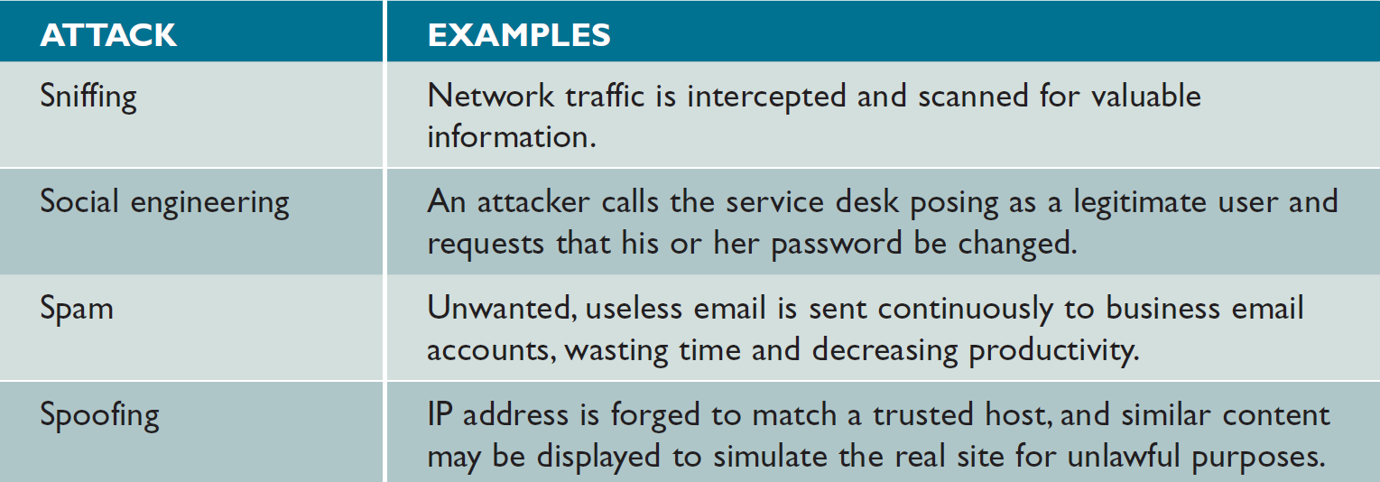
System Security Overview (Cont. 6)
Figure 12-22 Attacks can take many forms, as this table shows. IT security managers must be able to
detect these attacks and respond with suitable countermeasures.

Slide 35
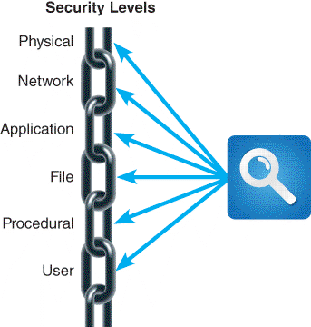
Security Levels
System security involves six separated but interrelated levels
Figure 12-23 Each security link has a specific focus, and the overall chain is only as strong as the weakest link.

Slide 36
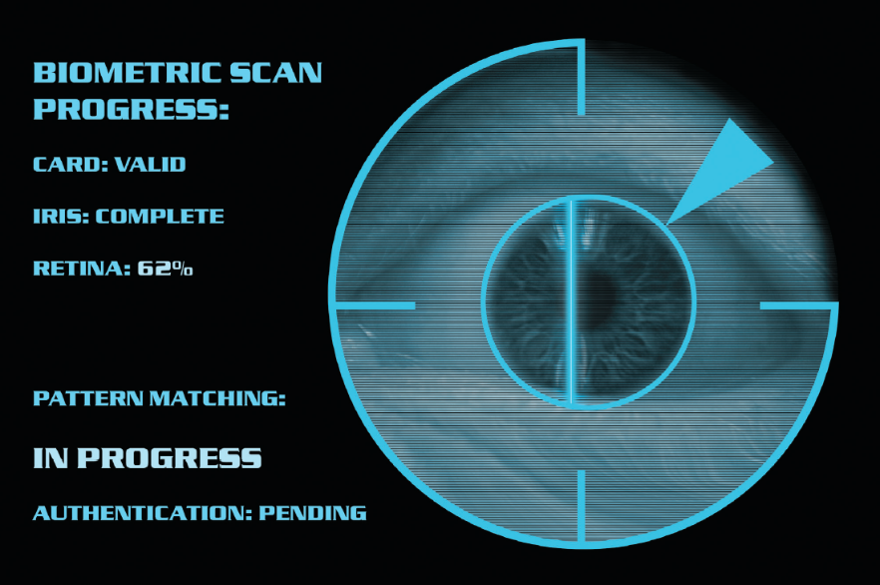
Security Levels (Cont. 1)
Physical Security
Operations center security - Each entrance must be equipped with a suitable security device
Servers and desktop computers
Install locks on server racks to avoid unauthorized placement of keystroke loggers
Tamper evident cases and BIOS-level passwords can be used
Figure 12-24 Companies use biometric scanning to analyse the features of the eye’s iris, which has more than 200 points that can be measured and used for comparison.
Andy Piatt/Shutterstock.com

Slide 37
Security Levels (Cont. 2)
Portable computers
Select an operating system with strong protection
Mark the computer’s case with the company name and address
Consider devices that have a built-in fingerprint reader and use the Universal Security Slot (USS) if available
Back up all vital data before using the computer outside the office and link the system to a tracking software
Be alert to high-risk situations while traveling
Establish stringent password protection policies

Slide 38
Security Levels (Cont. 3)
Network security
Encrypt network traffic
Encryption techniques - Private key encryption and public key encryption (PKE)
Wireless networks - WPA2 strengthens the level of wireless protection
Private networks can be used when speed is necessary
Virtual Private Networks (VPN) establish secure connections for a large number of computers

Slide 39
Security Levels (Cont. 4)
Ports and services can be affected by port scans and denial of service (DOS) attacks
A port routes incoming traffic to the correct application and a service monitors a particular port
Firewalls allow or block network traffic from each network interface based on preset rules
Network intrusion detection system (NDIS) alerts the administrator when it detects suspicious network traffic patterns

Slide 40
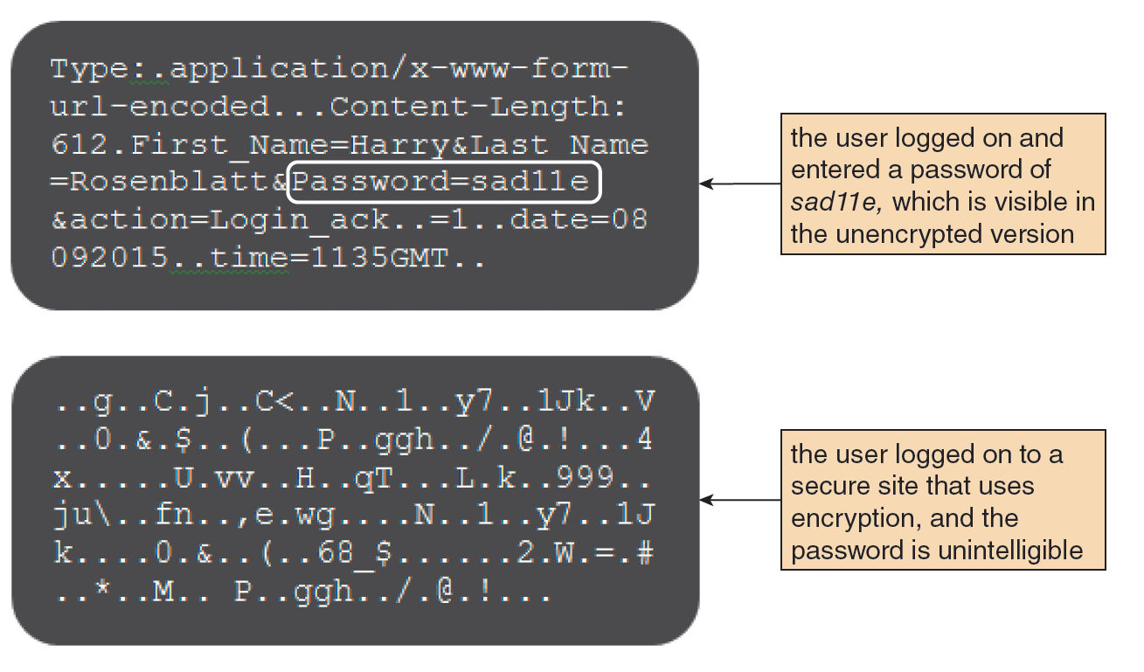
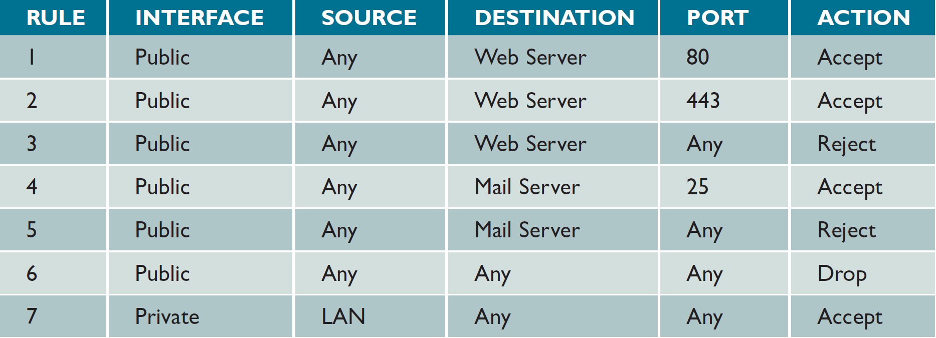
Security Levels (Cont. 5)
Figure 12-28 The upper screen shows an example of unencrypted text, which contains a visible password. In the lower screen, the encrypted text cannot be read.
Figure 12-31 Examples of rules that determine whether the firewall will allow traffic to pass.

Slide 41
Security Levels (Cont. 6)
Application Security
Services that are not needed must be disabled
Unnecessary or improperly configured service could create a security hole
Hardening: Removes unnecessary accounts, services, and features
Application permissions
To provide unauthorized changes applications must be configured to be run by users who have specific rights
Input validation helps safeguard data integrity and security

Slide 42
Security Levels (Cont. 7)
Patches and updates - Used to repair security holes, reduce vulnerabilities, and update the system
Software logs document all events
Help understand past attacks and prevent future intrusions
File Security
Encryption - Scrambles the contents of a file or document to protect it from unauthorized access
Permissions - Describe the rights a user has to a particular file or directory on a server
Administrators can create user groups and assign file permissions

Slide 43
Security Levels (Cont. 8)
User Security
Identity management: Controls and procedures necessary to identify legitimate users and system components
Strategy must balance technology, security, privacy, cost, and user productivity
Password protection
Password policies need to specify a set minimum length, complexity, and a limit on invalid attempts
Social engineering: Intruder uses social interaction to gain unauthorized access to a computer system
Includes pretexting

Slide 44
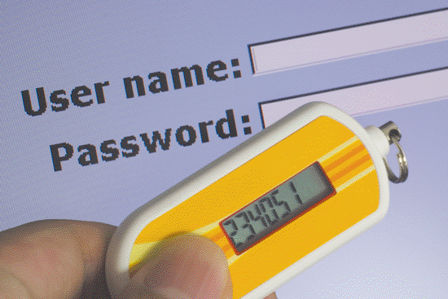
Security Levels (Cont. 9)
User resistance
Users need to understand and be a part of the organization’s commitment to security
New technologies can be used to enhance security and prevent unauthorized access
Figure 12-33 Security tokens, which come in various forms, can provide an additional level of security.
Lim Yong Hian/Shutterstock.com

Slide 45
Security Levels (Cont. 10)
Procedural Security (Operational Security)
Defines how particular tasks are to be performed
Includes safeguarding procedures that would be valuable to an attacker
Organization must explain procedures and issue reminders that will make security issues a priority

Slide 46
Backup and Recovery
Backup Policies
Backup media: Includes tape, hard drives optical and online storage
Offsiting: Storing backup away from the business location
Cloud-based storage is growing rapidly
Types - Full, differential, incremental, and continuous
Retention periods: Backups are stored for a specific time beyond which they are either destroyed or reused

Slide 47
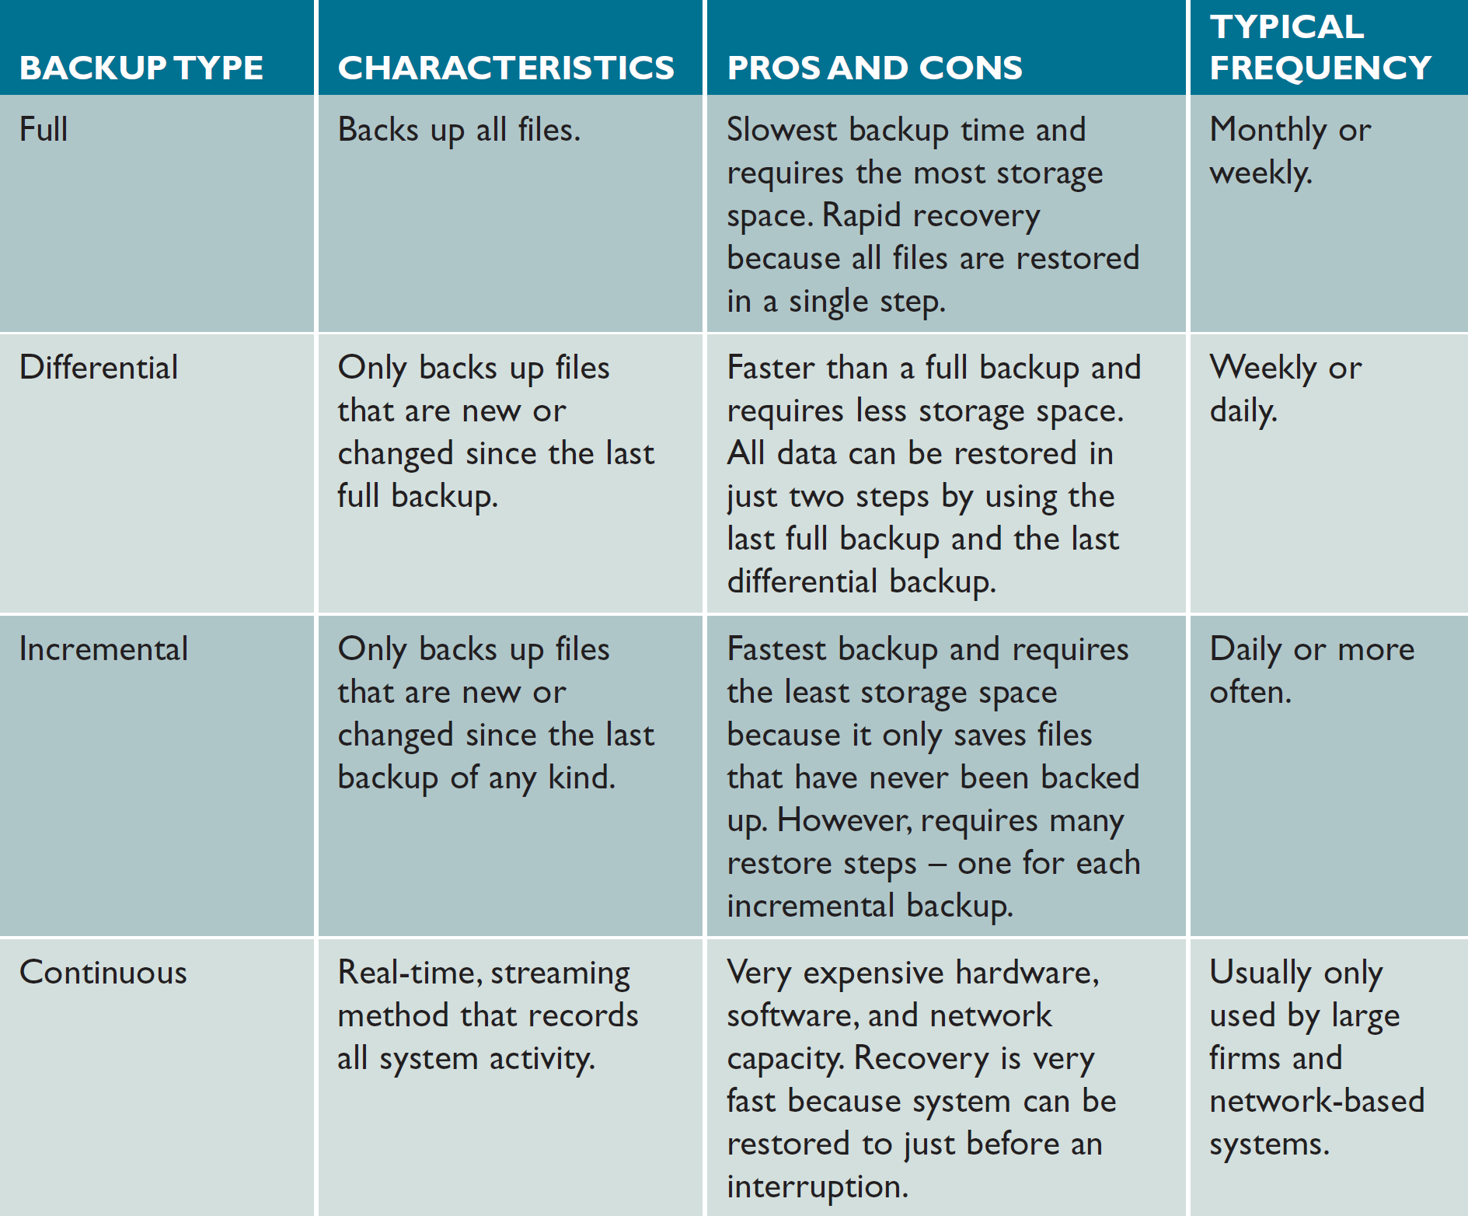
Backup and Recovery (Cont. 1)
Figure 12-34 Comparison of full, differential, incremental, and continuous backup methods.

Slide 48
Backup and Recovery (Cont. 2)
Business Continuity Issues
A disaster recovery plan should be created along with a test plan
Often part of a business continuity plan (BCP)
BCP: Defines how critical business functions can continue during a major disruption
Specifies the use of a hot site, which requires data replication

Slide 49
System Obsolescence
Factors indicating obsolescence
Adaptive and corrective maintenance are increasing steadily
Operational costs or execution times are increasing rapidly
A software package is available that provides the same or additional services more efficiently
New technology offers a way to perform the same or additional functions more efficiently
Maintenance changes or additions are difficult and expensive to perform
Users request significant new features

Slide 50
Future Challenges and Opportunities
Trends and Predictions
Cybercrime will increase significantly
Smartphones and tablets will become the dominant computing platform
Software-as-a-service will become the norm, which will affect business models and consumer costs
Cloud computing will become the principal computing infrastructure for the enterprise
Insourcing will increase due to economic factors
Large enterprises may require suppliers to certify their green credentials and sourcing policies

Slide 51
Future Challenges and Opportunities (Cont. 1)
Strategic Planning for IT Professionals
System analysts should work backwards from goals in order to develop intermediate milestones
IT Credentials and Certification
Professional organizations and IT industry leaders offer continuing educational courses and credentialed certifications
Critical Thinking Skills and CyberEthics
System analysts should:
Possess soft skills and critical thinking skills
Be able to address ethical, social, and legal aspects of IT

Slide 52
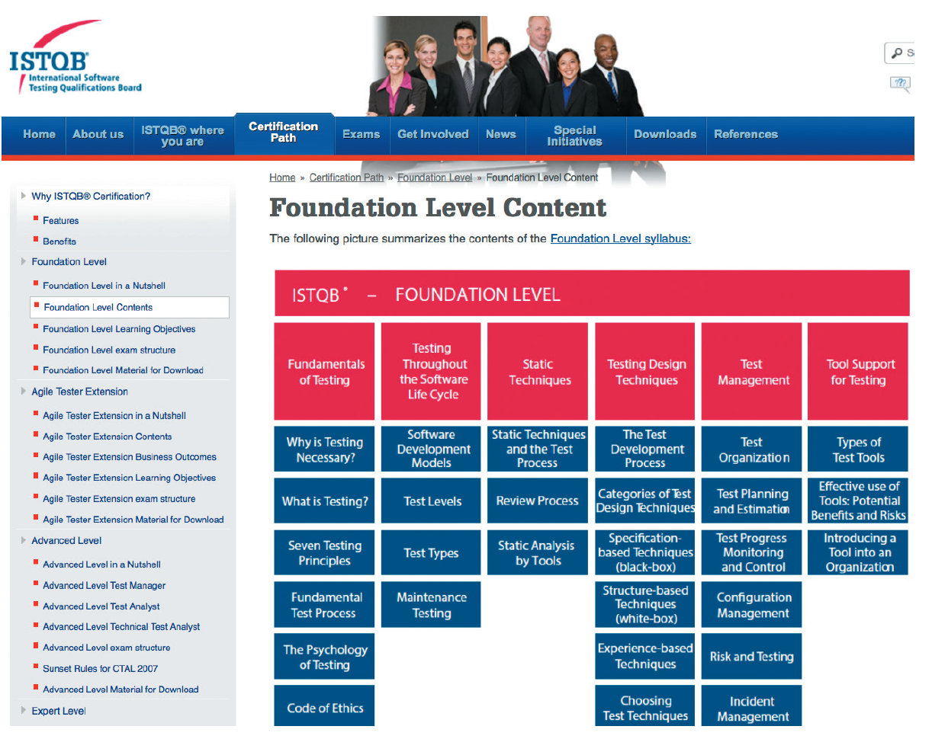
Future Challenges and Opportunities (Cont. 2)
Figure 12-37 ISTQB has created a very successful scheme for certifying software testers worldwide.
Source: ISTQB

Slide 53
Chapter Summary
Systems support and security cover the period from the implementation of an information system until the system no longer is used
Corrective, adaptive, perfective and preventative are types of system maintenance
A maintenance team consists of systems analysts and programmers
Configuration management and system performance measurements are necessities of maintenance management

Slide 54
Chapter Summary (Cont.)
Security is a vital part of every computer system
Risk management identifies, analyzes, anticipates and reduces risk to an acceptable level
Data backup and recovery plans are essential
All information systems eventually become obsolete
Intense competition is predicted in the future
IT professionals should have a strategic career plan

